Slide 1
Report Presentation on Support Vector Machine Machine Learning Algorithms
Link https://www.youtube.com/watch?v=tRuMrjY9fWE&feature=youtu.be
An interactive webinar of team S.G.S.I.T.S. Indore
Dr. M. Tanveer
Submitted By : Sakshi
IIT MANDI (H.P.)

Slide 2
Introductory Preface:
In this report after watching the webinar I wish to draw a comparative study of the CLASSICAL SUPPORT VECTOR MACHINE (SVM) ALGORITHM’S models and TWIN SUPPORT VECTOR MACHINE (TWSVM) ALGORITHM’S MODELS explained in the webinar in the terms of efficiency , complexity and time.
In SVM, basically the goal is to find the optimal separating hyperplane so that we can classify the nature of our future components in the different classes with minimum possible error to avoid any misclassifications of the data.
SVM is a NON PROBABILISTIC MEASURE of classification using its own algorithms unlike Random forest method.
So we analysed the different models under this Supervised Machine Learning with support vector machine.

Slide 3
Applications:
Disease detection, text categorization, software defect prediction, speech recognition, face identification, bankruptcy prediction, intrusion detection, time series forecasting, music emotion detection, etc.
Like in this pandemic time we can make devices to detect that a person entering is wearing a mask , gloves PPE kits etc. or not.instead of manual labour.

Slide 4
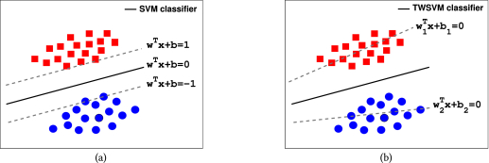


Linear SVM in 2D space
SVM
TWSVM
It is based on having two parallel planes based on the decision variables or support vectors as in the figure are $w^{T}+b=1$ and $w^{T}+b=−1$
Then working on the margin maximizing between them in order to find optimal separating hyperplane in the mid of the perpendicular line to both planes which is $w^{T}+b=0$.
Geometrical representation
It is based on having two non parallel hyperplanes closest to one set (say red points) and farest from the other set (say blue points) for the classification Which is ${w_{1}}^{T}+b_{1}=0$ and similarly ${w_{2}}^{T}+b_{2}=0$ for the blue points.
Binary classification of data in the form of matrices A and B is used.
Geometrical representation

Slide 5
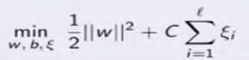
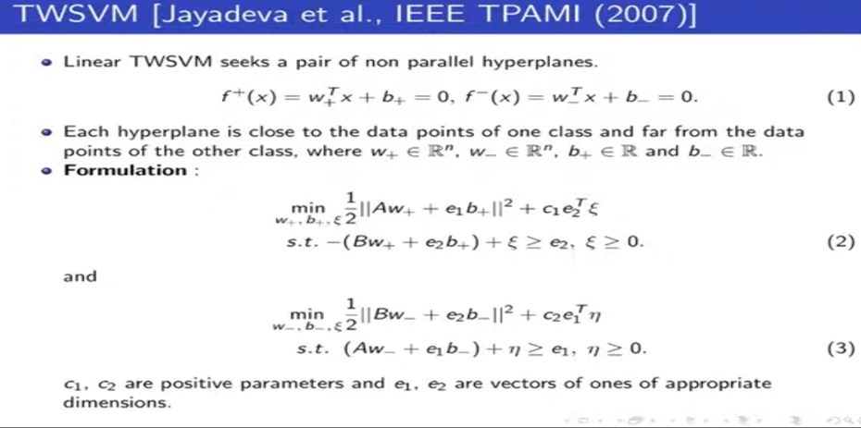
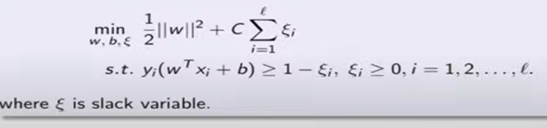


Continued…
While working for maximizing the margin which is given by M=$\frac{2}{||w||}$
Primal problem of the algorithm becomes :
where l is the total number of training points in the dataset and ξ is a slack variable added to avoid over fitting in case of noise subjected to the constraints as given below.
Where $y_{i}$ is +1 for red datapoints and -1 for blue datapoints.
With this we obtain the primal problem of the problem
Training Data points belong to class +1 and -1 in accordance with the matrices A and B.
So we divide l datapoints into two different sets of size $l_{1}$ and $l_{2}$.
So we come up with two objective
Where + and – signs are used to denote the data of red and blue datapoints respectively.
functions which are of much smaller size than a bigger one in case of svm which are pair of non parallel hyperplanes. Adding the constraints we can obtain primal.

Slide 6


CODE TRAINING TIME COMPLEXITY OF THE TWO……
In SVM , time consumed in finding the best separating plane is much higher than TWSVM as it can be observed we can draw a number of planes separating the datapoints taking different slopes. Finding optimal w for the $w^{T}+b=0.$
So the time complexity is O($n^{3}$) where n is the dimension of datapoints.
In TWSVM, our task is divided in two smaller optimization problems with forming two objective functions trained on the basis of $l_{1}{and l}_{2}$ datapoints on the basis of minimising the distance from respective datasets A and B.
The time complexity is ¼ ^{th} of the SVM i.e. O($n^{3}$/4).

Slide 7
Limitations of the two algo’s:
SVM
But complexity arise when the data is not linearly separable i.e. we cannot draw a plane separating the data.
Also figuring out best kernel functions is little complex.
TWSVM
While Working with millions of datapoints or large datasets a problem of calculating the matrix inverse while solving the optimization problem is tedious.
So it demands matrix to be non singular

Slide 8
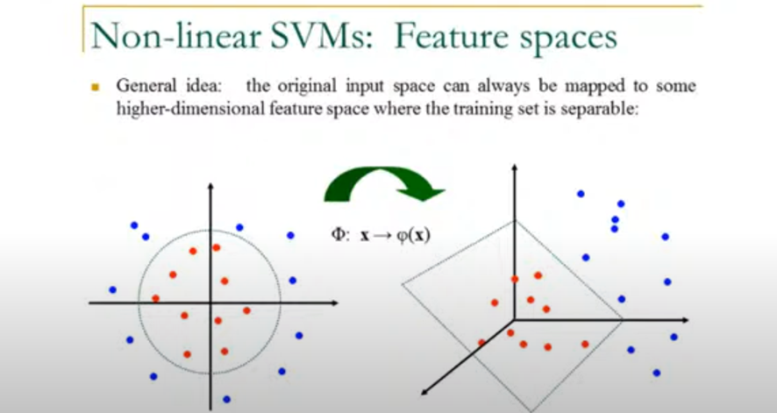
Non linear SVM:
In non linear SVM we just use a linear transformation on the vectors x to change them to higher dimension such that the training data becomes linearly separable .
For non linear cases in all the algorithms of linear svm we just replace the vector x with φ(x) where φ is the respective linear transformation used in it.
As the picture shows that
change in dimension of
the datapoints make them
Linearly separable in
Higher Dimension. ►

Slide 9
How in my insight TWSVM is better than SVM……
Just an Observation :
That in case of SVM as we draw a single separating hyperplane for the classification of two types of datasets. If we get a new point (to predict its type/nature) lies itself on the separating hyperplane itself , we have no conclusion about its nature.
Whereas in case of TWSVM where we draw two planes for each datasets and than see the distances of the new point to predict from each plane and classify its type on the basis of the closeness from the plane . So no such problem arises as in the above case.

Slide 10
Further Classification the two models
SVM
K Nearest Neighbour model based on Euclidean distance theory between the data points.
Linear regression based techniques.
In case the it fails to linearly separate data ,than introducing soft margin SVM which alters our objective function by adding a slack variable.
Kernel method for changing the dimension of the original data points so that a separating hyperplane drawing becomes visible.
TWSVM
Twin bounded SVM based on structural risk minimization and uses successive over relaxation.
1. This is an iterative approach towards optimality similar to the gauss seidel method.
2. Much faster than TWSVM
Least Squares TWSVM :in this model instead of using one norm of the vectors we use squared norm of the slack variable ξ in the objective functions of TWSVM.
Robust Energy based TWSVM
Large scale least squares TWSVM
Pinball TWSVM

Slide 11
References :--
https://www.researchgate.net/publication/257513017_An_overview_on_twin_support_vector_machines (An overview of TWSVM by Dr. Jaydev and others).
M. Tanveer, S. Sharma, K. Muhammad (2020). Large scale least squares twin SVMs, ACM Transactions on Internet Technology. [SCI Indexed with Impact Factor: 2.38] 2020
https://pythonprogramming.net/machine-learning-tutorial-python-introduction/ (MACHINE LEARNING with python)
Mr. Ashish Jain currently working with WIPRO, Delhi.
Other online references and research.

Slide 12
Conclusion :
Twin support vector machine algorithm is far way better than the conventional support vector machine in many ways.
While further improvements in even that can make it work even better.

